Slide 1
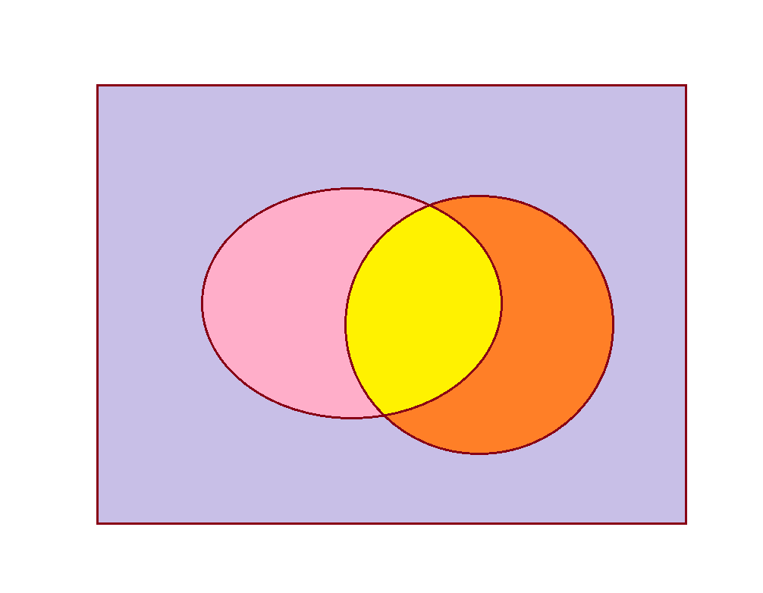




Simplify if possible:
$\overline{\text{B}}$ C + B $\overline{\text{C}}$
( B + $\overline{\text{B}}$ ) ∙ ( C + $\overline{\text{C}}$ ) = B ∙ C + $\overline{\text{B}}$ ∙ C + B ∙ $\overline{\text{C}}$ + $\overline{\text{B}}$ ∙ $\overline{\text{C}}$
B ∙ $\overline{\text{C}}$
B ∙ C
$\overline{\text{B}}$ ∙ C
$\overline{\text{B}}$ ∙ $\overline{\text{C}}$

Slide 2
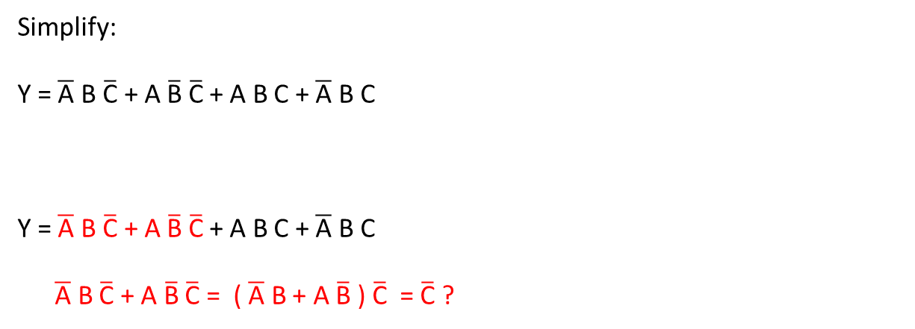
Simplify:
Y = $\overline{\text{A}}$ B $\overline{\text{C}}$ + A $\overline{\text{B}}$ $\overline{\text{C}}$ + A B C + $\overline{\text{A}}$ B C
Y = $\overline{\text{A}}$ B $\overline{\text{C}}$ + A $\overline{\text{B}}$ $\overline{\text{C}}$ + A B C + $\overline{\text{A}}$ B C
$\overline{\text{A}}$ B $\overline{\text{C}}$ + A $\overline{\text{B}}$ $\overline{\text{C}}$ = ( $\overline{\text{A}}$ B + A $\overline{\text{B}}$ ) $\overline{\text{C}}$ = $\overline{\text{C}}$ ?

Slide 3

Y = $\overline{\text{A}}$ B $\overline{\text{C}}$ + A $\overline{\text{B}}$ $\overline{\text{C}}$ + A B C + $\overline{\text{A}}$ B C
Y = $\overline{\text{A}}$ B $\overline{\text{C}}$ + A $\overline{\text{B}}$ $\overline{\text{C}}$ + A B C + $\overline{\text{A}}$ B C
A $\overline{\text{B}}$ $\overline{\text{C}}$ + A B C = A ( $\overline{\text{B}}$ $\overline{\text{C}}$ + B C ) = A ?

Slide 4
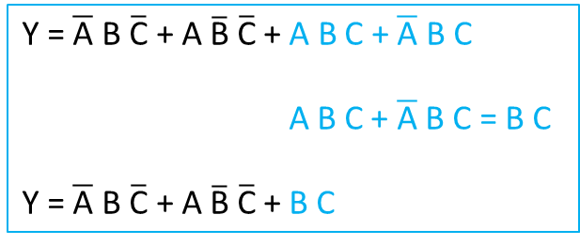
Y = $\overline{\text{A}}$ B $\overline{\text{C}}$ + A $\overline{\text{B}}$ $\overline{\text{C}}$ + A B C + $\overline{\text{A}}$ B C
A B C + $\overline{\text{A}}$ B C = B C
Y = $\overline{\text{A}}$ B $\overline{\text{C}}$ + A $\overline{\text{B}}$ $\overline{\text{C}}$ + B C

Slide 5
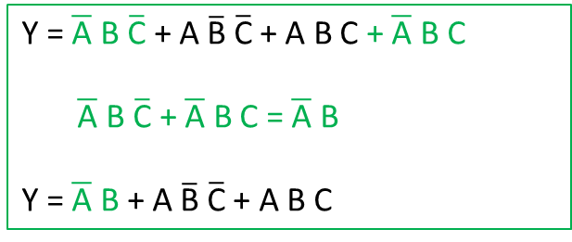
OR
Y = $\overline{\text{A}}$ B $\overline{\text{C}}$ + A $\overline{\text{B}}$ $\overline{\text{C}}$ + A B C + $\overline{\text{A}}$ B C
$\overline{\text{A}}$ B $\overline{\text{C}}$ + $\overline{\text{A}}$ B C = $\overline{\text{A}}$ B
Y = $\overline{\text{A}}$ B + A $\overline{\text{B}}$ $\overline{\text{C}}$ + A B C

Slide 6
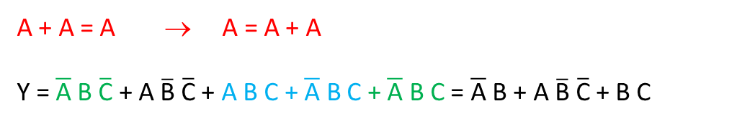
Y = $\overline{\text{A}}$ B $\overline{\text{C}}$ + A $\overline{\text{B}}$ $\overline{\text{C}}$ + A B C + $\overline{\text{A}}$ B C
A B C + $\overline{\text{A}}$ B C = B C
Y = $\overline{\text{A}}$ B $\overline{\text{C}}$ + A $\overline{\text{B}}$ $\overline{\text{C}}$ + B C
Y = $\overline{\text{A}}$ B $\overline{\text{C}}$ + A $\overline{\text{B}}$ $\overline{\text{C}}$ + A B C + $\overline{\text{A}}$ B C
$\overline{\text{A}}$ B $\overline{\text{C}}$ + $\overline{\text{A}}$ B C = $\overline{\text{A}}$ B
Y = $\overline{\text{A}}$ B + A $\overline{\text{B}}$ $\overline{\text{C}}$ + A B C
AND!
A + A = A → A = A + A
Y =$\overline{\text{A}}$ B $\overline{\text{C}}$ + A $\overline{\text{B}}$ $\overline{\text{C}}$ + A B C + $\overline{\text{A}}$ B C + $\overline{\text{A}}$ B C = $\overline{\text{A}}$ B + A $\overline{\text{B}}$ $\overline{\text{C}}$ + B C

Slide 7
Karnaugh-table
 | B C | 0 0 | 0 1 | 1 1 | 1 0
A
0
1

Slide 8
Karnaugh-table
 | B C | 0 0 | 0 1 | 1 1 | 1 0
A
0 |  |  | 1 | 1 | 1
1 |  |  |  | 1

Slide 9
Karnaugh-table
 | B C | 0 0 | 0 1 | 1 1 | 1 0
A
0 |  |  | 1 | 1 | 1
1 |  |  |  | 1
 |  |  |  | ↓ BC
BC

Slide 10

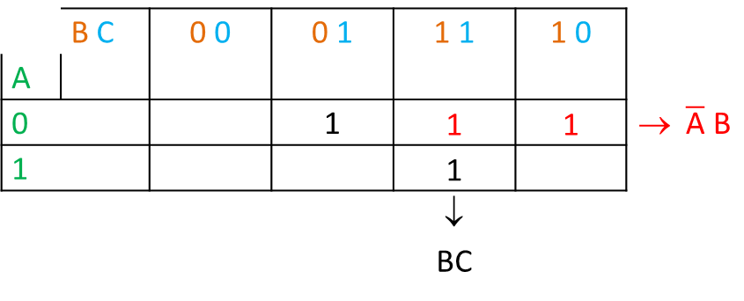
Karnaugh-table
 | B C | 0 0 | 0 1 | 1 1 | 1 0
A
0 |  |  | 1 | 1 | 1 | → $\overline{\text{A}}$ B
1 |  |  |  | 1
 |  |  |  | ↓ BC
BC + $\overline{\text{A}}$ B

Slide 11

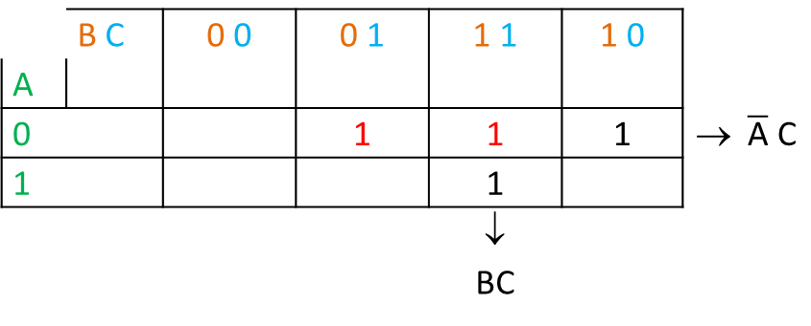
Karnaugh-table
 | B C | 0 0 | 0 1 | 1 1 | 1 0
A
0 |  |  | 1 | 1 | 1 | → $\overline{\text{A}}$ C
1 |  |  |  | 1
 |  |  |  | ↓ BC
BC + $\overline{\text{A}}$ B + $\overline{\text{A}}$ C

Slide 12
Karnaugh-table
 | B C | 0 0 | 0 1 | 1 1 | 1 0
A
0 |  |  | 1 | 1 | 1
1 |  |  | 1

Slide 13
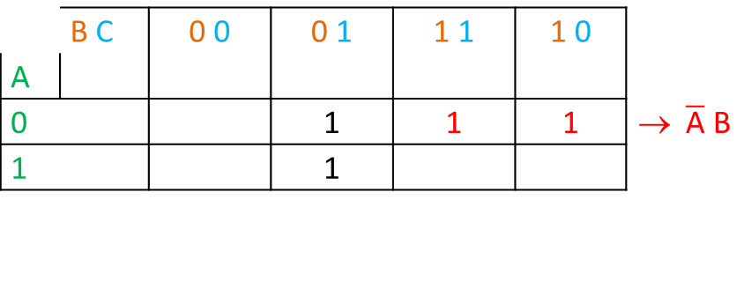
Karnaugh-table
 | B C | 0 0 | 0 1 | 1 1 | 1 0
A
0 |  |  | 1 | 1 | 1 | → $\overline{\text{A}}$ B
1 |  |  | 1

Slide 14

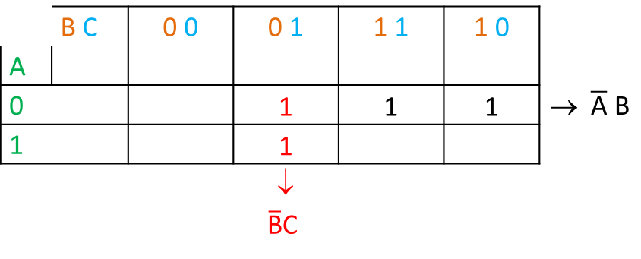
Karnaugh-table
 | B C | 0 0 | 0 1 | 1 1 | 1 0
A
0 |  |  | 1 | 1 | 1 | → $\overline{\text{A}}$ B
1 |  |  | 1
 |  |  | ↓ $\overline{\text{B}}$C
$\overline{\text{A}}$ B + $\overline{\text{B}}$ C

Slide 15

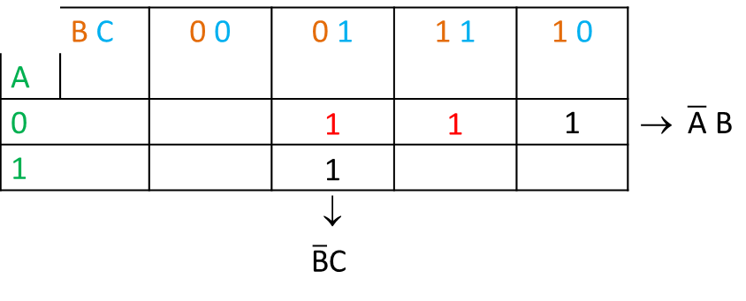
Karnaugh-table
 | B C | 0 0 | 0 1 | 1 1 | 1 0
A
0 |  |  | 1 | 1 | 1 | → $\overline{\text{A}}$ B
1 |  |  | 1
 |  |  | ↓ $\overline{\text{B}}$C
$\overline{\text{A}}$ B + $\overline{\text{B}}$ C is enough

Slide 16
Karnaugh-table
 | B C | 0 0 | 0 1 | 1 1 | 1 0
A
0 |  | 1 |  | 1 | 1
1 |  |  |  | 1
 |  |  |  | ↓ BC

Slide 17

Karnaugh-table
 | B C | 0 0 | 0 1 | 1 1 | 1 0
A
0 |  | 1 |  | 1 | 1
1 |  |  |  | 1
 |  |  |  | ↓ BC
BC + $\overline{\text{A}} \overline{\text{C}}$

Slide 18
Karnaugh-table
 | B C | 0 0 | 0 1 | 1 1 | 1 0
A
0 |  |  |  | 1 | 1
1 |  |  |  | 1 | 1

Slide 19
Karnaugh-table
 | B C | 0 0 | 0 1 | 1 1 | 1 0
A
0 |  |  |  | 1 | 1
1 |  |  |  | 1 | 1
B

Slide 20
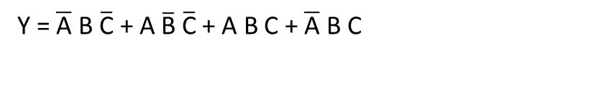
Y = $\overline{\text{A}}$ B $\overline{\text{C}}$ + A $\overline{\text{B}}$ $\overline{\text{C}}$ + A B C + $\overline{\text{A}}$ B C
 | B C | 0 0 | 0 1 | 1 1 | 1 0
A
0
1

Slide 21
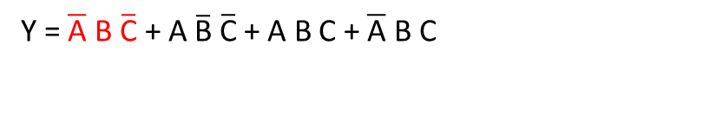
Y = $\overline{\text{A}}$ B $\overline{\text{C}}$ + A $\overline{\text{B}}$ $\overline{\text{C}}$ + A B C + $\overline{\text{A}}$ B C
 | B C | 0 0 | 0 1 | 1 1 | 1 0
A
0 |  |  |  |  | 1
1

Slide 22
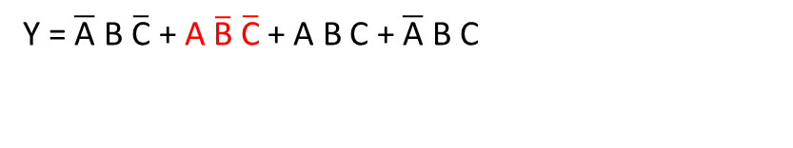
Y = $\overline{\text{A}}$ B $\overline{\text{C}}$ + A $\overline{\text{B}}$ $\overline{\text{C}}$ + A B C + $\overline{\text{A}}$ B C
 | B C | 0 0 | 0 1 | 1 1 | 1 0
A
0 |  |  |  |  | 1
1 |  | 1

Slide 23
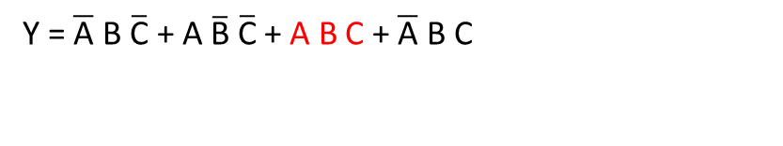
Y = $\overline{\text{A}}$ B $\overline{\text{C}}$ + A $\overline{\text{B}}$ $\overline{\text{C}}$ + A B C + $\overline{\text{A}}$ B C
 | B C | 0 0 | 0 1 | 1 1 | 1 0
A
0 |  |  |  |  | 1
1 |  | 1 |  | 1

Slide 24
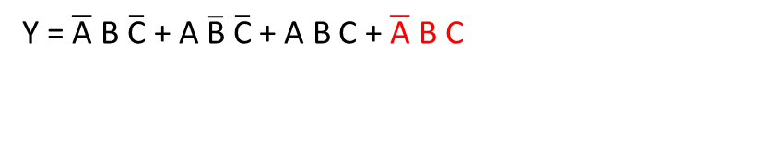
Y = $\overline{\text{A}}$ B $\overline{\text{C}}$ + A $\overline{\text{B}}$ $\overline{\text{C}}$ + A B C + $\overline{\text{A}}$ B C
 | B C | 0 0 | 0 1 | 1 1 | 1 0
A
0 |  |  |  | 1 | 1
1 |  | 1 |  | 1

Slide 25
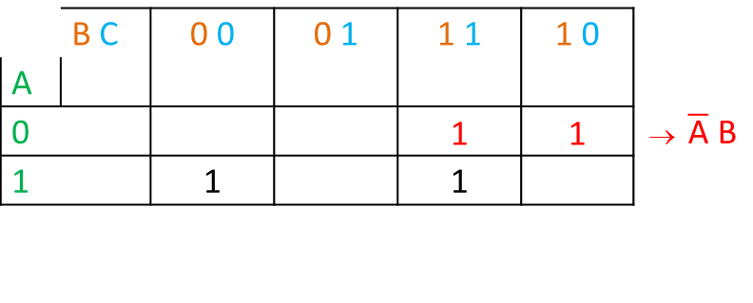
Y = $\overline{\text{A}}$ B $\overline{\text{C}}$ + A $\overline{\text{B}}$ $\overline{\text{C}}$ + A B C + $\overline{\text{A}}$ B C
 | B C | 0 0 | 0 1 | 1 1 | 1 0
A
0 |  |  |  | 1 | 1 | → $\overline{\text{A}}$ B
1 |  | 1 |  | 1

Slide 26
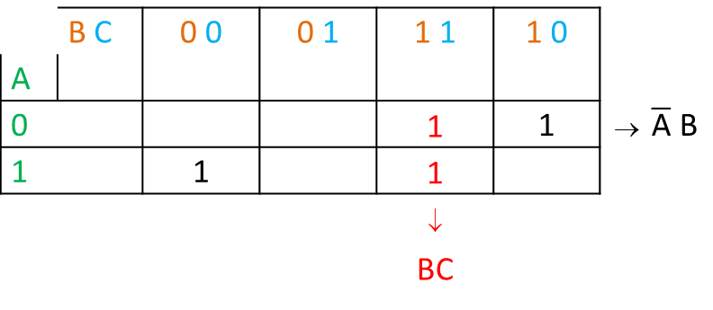
Y = $\overline{\text{A}}$ B $\overline{\text{C}}$ + A $\overline{\text{B}}$ $\overline{\text{C}}$ + A B C + $\overline{\text{A}}$ B C
 | B C | 0 0 | 0 1 | 1 1 | 1 0
A
0 |  |  |  | 1 | 1 | → $\overline{\text{A}}$ B
1 |  | 1 |  | 1
 |  |  |  | ↓ BC

Slide 27
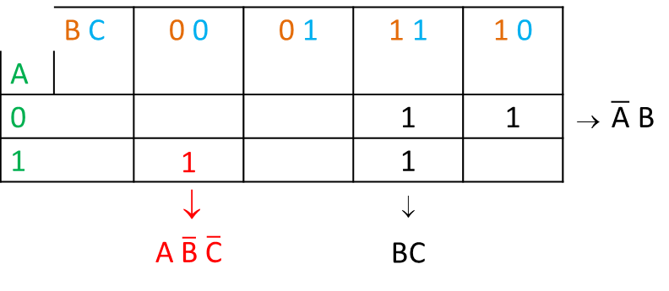
Y = $\overline{\text{A}}$ B $\overline{\text{C}}$ + A $\overline{\text{B}}$ $\overline{\text{C}}$ + A B C + $\overline{\text{A}}$ B C
 | B C | 0 0 | 0 1 | 1 1 | 1 0
A
0 |  |  |  | 1 | 1 | → $\overline{\text{A}}$ B
1 |  | 1 |  | 1
 |  | ↓ A $\overline{\text{B}}$ $\overline{\text{C}}$ |  | ↓ BC
Y = $\overline{\text{A}}$ B + B C + A $\overline{\text{B}}$ $\overline{\text{C}}$

