Slide 1
Dynamical systems linear stability analysis

Slide 2
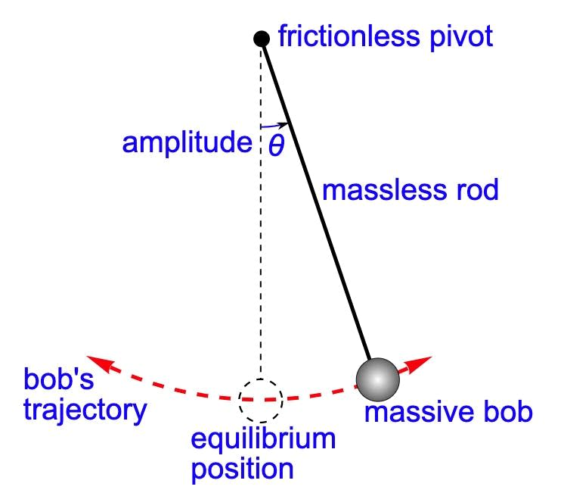
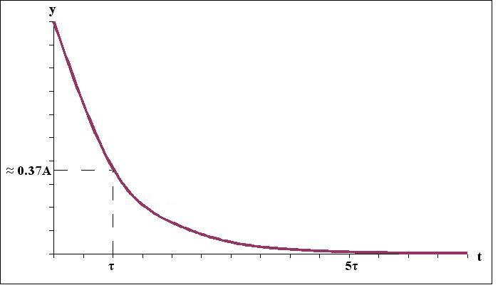
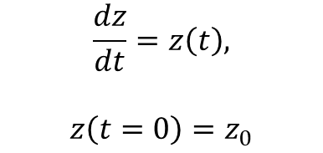
Introduction
Main questions in science?
System behavior at t →∞, i.e., describing quantities characterizing the system
(ii) Stability analysis
Ordinary differential equations (ODEs), partial differential equations (PDEs)
System: Θ
Equilibrium point
Steady state (ss)
Θ = constant
dΘ/dt = 0
Two steady states:
Θ = 0
Θ = π
$$\frac{dz}{dt}=z\left(t\right),$$
$$z\left(t=0\right)=z_{0}$$
z
Stable ss
Unstable ss
Perturbation of the steady states
time

Slide 3
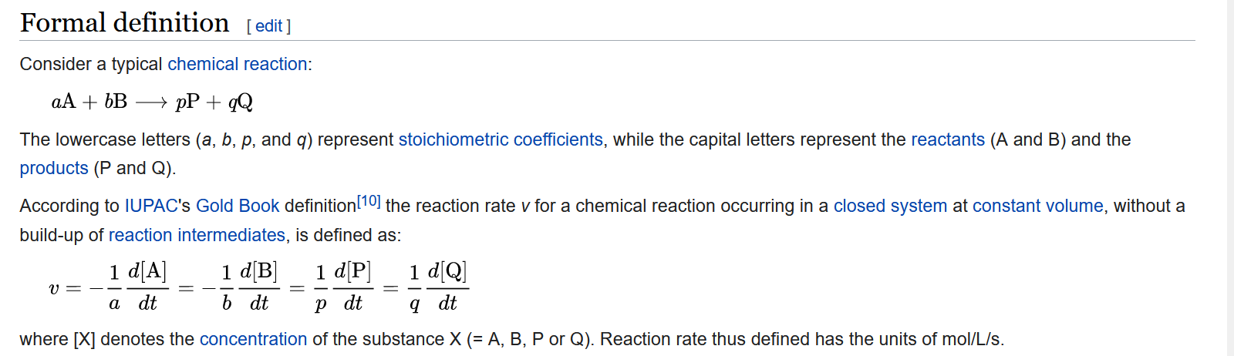
Chemical kinetics

Slide 4
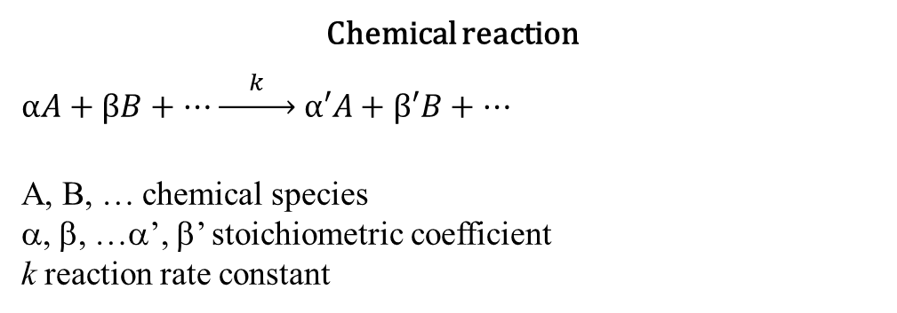
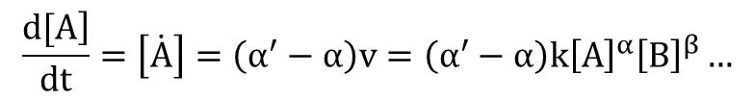
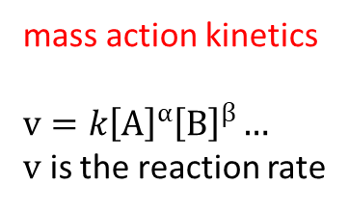
Chemical kinetics
Chemical reaction
$αA+βB+…\underset{→}{ k } α′A+β′B+…$
A, B, … chemical species
α, β, …α’, β’ stoichiometric coefficient
k reaction rate constant
mass action kinetics
$v=k{\left[A\right]}^{α}{\left[B\right]}^{β}…$
$v$ is the reaction rate
$$\frac{\left.d[A\right]}{dt}=\left[\dot{A}\right]=\left(α^{′}−α\right)v=\left(α^{′}−α\right)k{\left[A\right]}^{α}{\left[B\right]}^{β}…$$
r is the number of chemical reactions

Slide 5
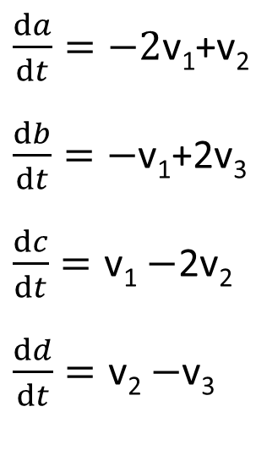
Examples
reaction mechanism
$\frac{da}{dt}=−2\text{v}\text{1}$+v₂
$\frac{db}{dt}=−\text{v}\text{1}$+2v₃
$\frac{dc}{dt}=\text{v}\text{1}−$2v₂
$\frac{dd}{dt}=\text{v}\text{2}−$v₃
2A + B → C
2C → D + A
D → 2B
v₁=k₁ab
v₂=k₂c²
v₃=k₃d
1
2

Slide 6
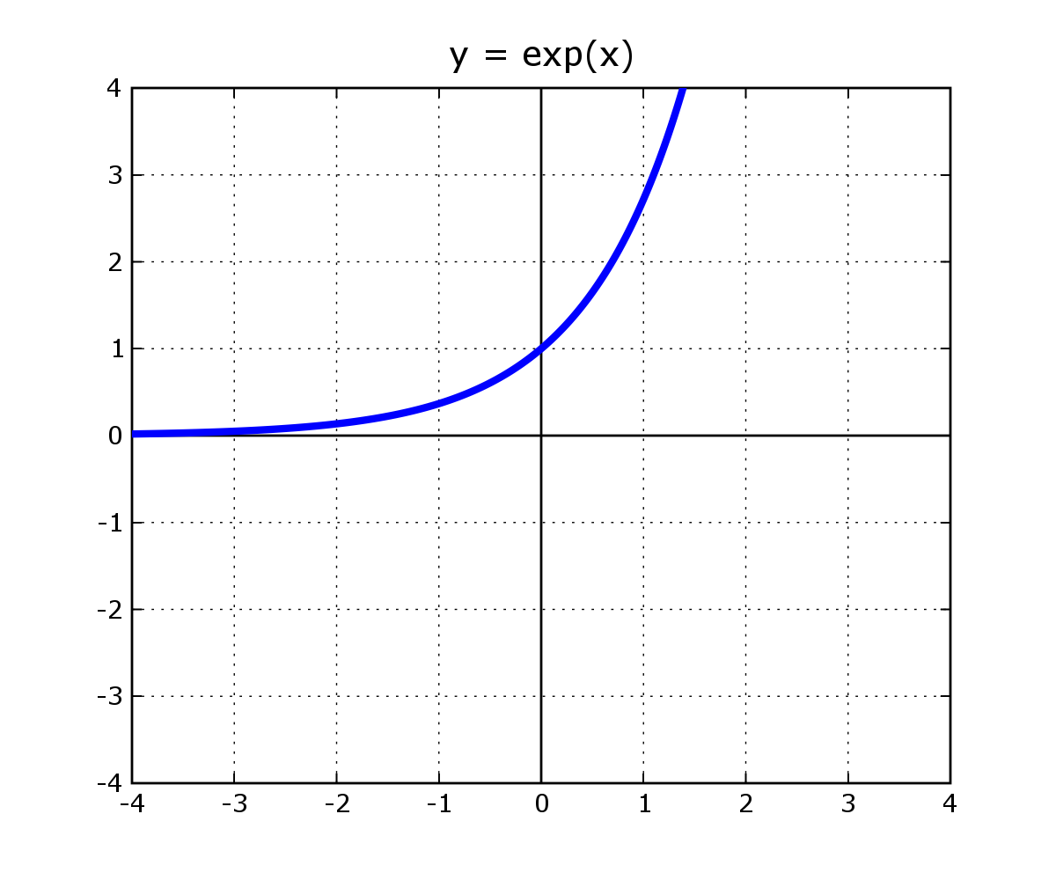
Set of linear differential equations
1D
dx/dt = kx, x(t = 0) = x₀
Steady state: if dx/dt = 0 → kx = 0 → x_{ss}= 0
Solution: x(t) = x₀∙e^{kt}
Steady state at x = 0,
if k < 0 stable ss; x(t) → 0, i.e., goes to the ss
if k ≥ 0 unstable ss; x(t) → ∞
if t → ∞, e^{kt} → ∞

Slide 7
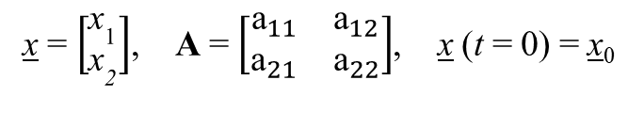
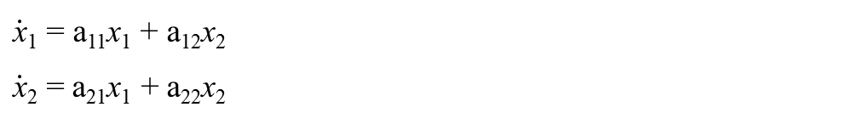

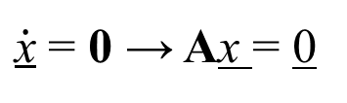
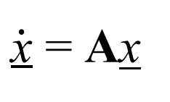
Set of linear differential equations
2D
$\dot{\text{x}}$₁ = a₁₁x₁ + a₁₂x₂
$\dot{\text{x}}$₂ = a₂₁x₁ + a₂₂x₂
$\dot{\text{x}}$ = Ax
x = $\left[\begin{matrix}{\text{x}}_{\text{1}} \\ {\text{x}}_{\text{2}}\end{matrix}\right]$, A = $\left[\begin{matrix}{\text{a}}_{11} & {\text{a}}_{12} \\ {\text{a}}_{21} & {\text{a}}_{22}\end{matrix}\right]$, x (t = 0) = x₀
(i) What is the steady state?
(ii) Solution?
$\dot{\text{x}}$ = 0 → Ax = 0
$$\underline{x}(t)=\underline{s_{i}}e^{λ_{i}t}$$
0 = a₁₁x₁ + a₁₂x₂
0 = a₂₁x₁ + a₂₂x₂
eigenvector
Eigenvalue of A
x_{ss}= 0

Slide 8
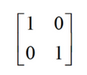

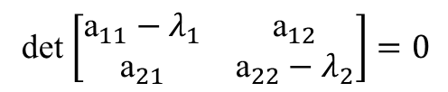
Set of linear differential equations
2D
$\dot{\text{x}}$₁ = a₁₁x₁ + a₁₂x₂
$\dot{\text{x}}$₂ = a₂₁x₁ + a₂₂x₂
$\dot{\text{x}}$ = Ax
Eigenvalue of A
x = $\left[\begin{matrix}{\text{x}}_{\text{1}} \\ {\text{x}}_{\text{2}}\end{matrix}\right]$, A = $\left[\begin{matrix}{\text{a}}_{11} & {\text{a}}_{12} \\ {\text{a}}_{21} & {\text{a}}_{22}\end{matrix}\right]$, x (t = 0) = x₀
det(A–λE) = 0
(i) What is the steady state?
(ii) Solution?
A = $\left[\begin{matrix}{\text{a}}_{11} & {\text{a}}_{12} \\ {\text{a}}_{21} & {\text{a}}_{22}\end{matrix}\right]$
$\dot{\text{x}}$ = 0 → Ax = 0
$$\underline{x}(t)=\underline{s_{i}}e^{λ_{i}t}$$
det $\left[\begin{matrix}{\text{a}}_{11}−λ_{1} & {\text{a}}_{12} \\ {\text{a}}_{21} & {\text{a}}_{22}−λ_{2}\end{matrix}\right]=0$
0 = a₁₁x₁ + a₁₂x₂
0 = a₂₁x₁ + a₂₂x₂
eigenvector
eigenvalues of A
λ² – (a₁₁+a₂₂) λ + (a₁₁a₂₂ – a₁₂a₂₁) = 0
x_{ss}= 0

Slide 9
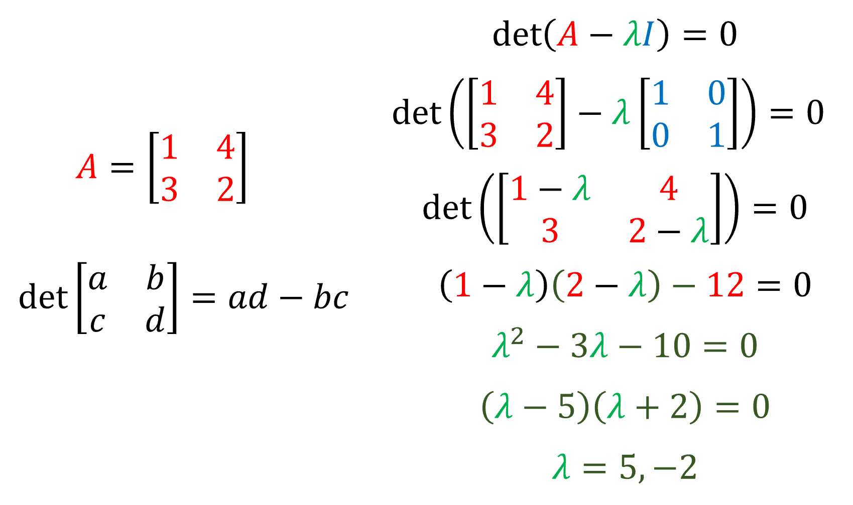
Set of linear differential equations
2D

Slide 10


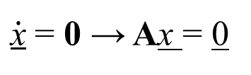
Set of linear differential equations
2D
t → ∞
if λ > 0 then e^{λt} → ∞
(λt → ∞) UNSTABLE
if λ < 0 then e^{λt} → 0
(λt → -∞) STABLE
(i) What is the steady state?
(ii) Solution?
$\dot{\text{x}}$ = 0 → Ax = 0
$$\underline{x}(t)=\underline{s_{i}}e^{λ_{i}t}$$
0 = a₁₁x₁ + a₁₂x₂
0 = a₂₁x₁ + a₂₂x₂
eigenvector
eigenvalues of A
x_{ss}= 0

Slide 11
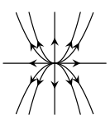
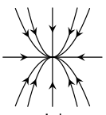

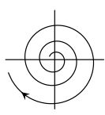
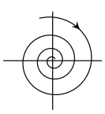

Set of linear differential equations
2D - solutions
λ₁ > 0, λ₂ > 0, both are real
unstable node
λ₁ < 0, λ₂ < 0, both are real
stable node
λ₁ > 0, λ₂ < 0 or λ₁ < 0, λ₂ > 0 and both are real
saddle
λ = Re(λ) ± Im(λ) and Re(λ) > 0
unstable focus
λ = Re(λ) ± Im(λ) and Re(λ) < 0
stable focus
λ = Re(λ) ± Im(λ) and Re(λ) = 0
center

Slide 12
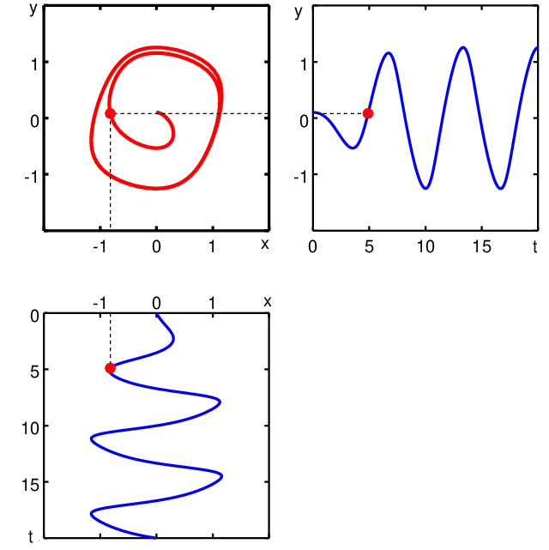
Phase portrait

Slide 13
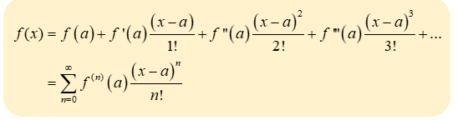
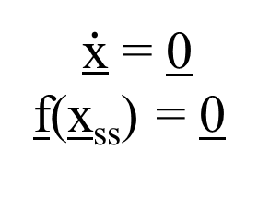
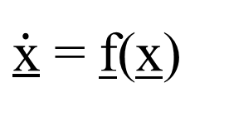
Set of non-linear differential equations
Linear stability analysis
2D
$\dot{\text{x}}$ = f(x)
(ii) Solution?
NO analytical solution → numerical solution
(i) What is the steady state?
x = x_{ss} + ξ
perturbation (small)
$\dot{\text{x}}$ = 0
f(x_{ss}) = 0
d(x_{ss} + ξ)/dt = f (x_{ss} + ξ)
dx_{ss}/dt + dξ/dt = f (x_{ss} + ξ)
dξ/dt = f (x_{ss} + ξ)
By definition dx_{ss}/dt = 0
Taylor expansion

Slide 14
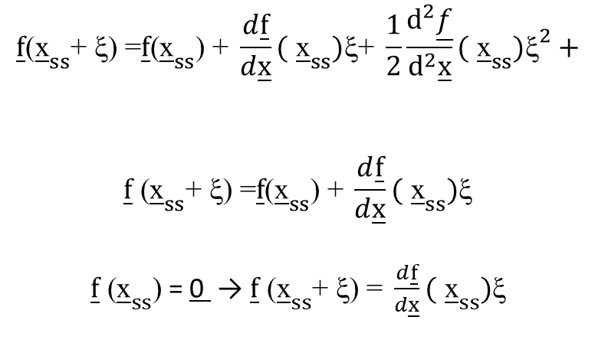
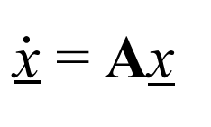
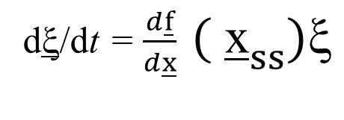
Set of non-linear differential equations
Linear stability analysis
2D
$$\underline{f}\text{(}{\underline{\text{x}}}_{ss}\text{+ }\text{ξ}\text{) =}\underline{f}\text{(}{\underline{\text{x}}}_{ss}\text{) + }\frac{d\underline{f}}{d\underline{x}}\text{(} {\underline{\text{x}}}_{ss})\text{ξ}\text{+ }\frac{1}{2}\frac{d^{2}\underline{f}}{d^{2}\underline{x}}\text{(} {\underline{\text{x}}}_{ss}){\text{ξ}}^{2}+$$
$$\underline{f}\text{ (}{\underline{\text{x}}}_{ss}\text{+ }\text{ξ}\text{) =}\underline{f}\text{(}{\underline{\text{x}}}_{ss}\text{) + }\frac{d\underline{f}}{d\underline{x}}\text{(} {\underline{\text{x}}}_{ss})\text{ξ}$$
$\underline{f}\text{ (}{\underline{\text{x}}}_{ss}\text{)}$ = 0 → $\underline{f}\text{ (}{\underline{\text{x}}}_{ss}\text{+ }\text{ξ}\text{) = }\frac{d\underline{f}}{d\underline{x}}\text{(} {\underline{\text{x}}}_{ss})\text{ξ}$
x = x_{ss} + ξ
d(x_{ss} + ξ)/dt = f (x_{ss} + ξ)
dx_{ss}/dt + dξ/dt = f (x_{ss} + ξ)
dξ/dt = f (x_{ss} + ξ)
dξ/dt = $\frac{d\underline{f}}{d\underline{x}} \text{(} {\underline{\text{x}}}_{ss})\text{ξ}$
Linear differential equation for the perturbation
$\dot{\text{x}}$ = Ax

Slide 15
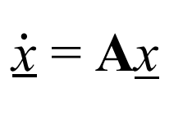
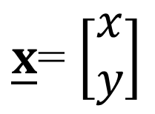
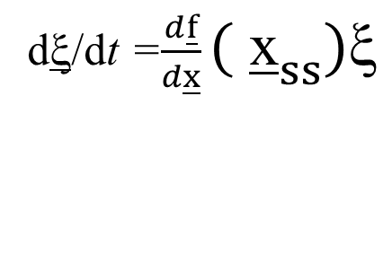
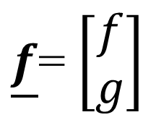
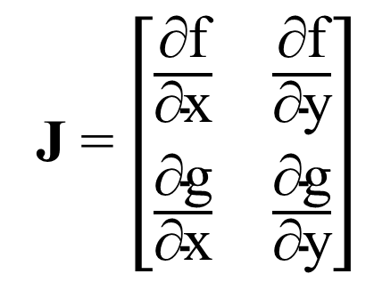
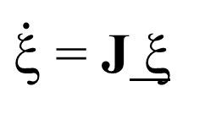
Set of non-linear differential equations
Linear stability analysis
2D
dξ/dt =$\frac{d\underline{f}}{d\underline{x}}\text{(} {\underline{\text{x}}}_{ss})\text{ξ}$
Linear differential equation for the perturbation
$\dot{\text{x}}$ = Ax
$\dot{\text{ξ}}$ = J ξ
J is the Jacobian matrix
J = $\left[\begin{matrix}\frac{\text{}\text{f}}{\text{}\text{x}} & \frac{\text{}\text{f}}{\text{}\text{y}} \\ \frac{\text{}\text{g}}{\text{}\text{x}} & \frac{\text{}\text{g}}{\text{}\text{y}}\end{matrix}\right]$
$\underline{f}$= $\left[\begin{matrix}f \\ g\end{matrix}\right]$
$\underline{x}$= $\left[\begin{matrix}x \\ y\end{matrix}\right]$

Slide 16
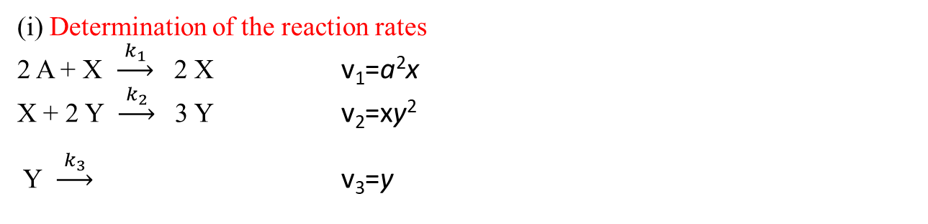
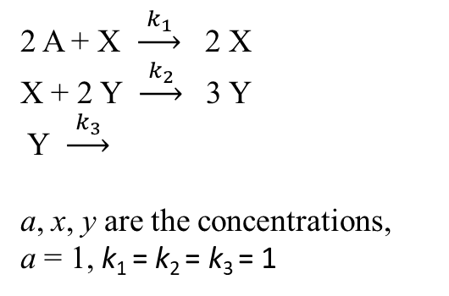
Problem
2 A + X $\underset{→}{{ k}_{1 }}$ 2 X
X + 2 Y $\underset{→}{{ k}_{2 }}$ 3 Y
Y $\underset{→}{{ k}_{3 }}$
a, x, y are the concentrations,
a = 1, k₁ = k₂ = k₃ = 1
Find the steady states of the system
Calculate the Jabobian matrix and calculate the eigenvalues
Characterize the steady states
Check your solution with the PhasePictor software
(i) Determination of the reaction rates
2 A + X $\underset{→}{{ k}_{1 }}$ 2 X v₁=a²x
X + 2 Y $\underset{→}{{ k}_{2 }}$ 3 Y v₂=xy²
Y $\underset{→}{{ k}_{3 }}$ v₃=y

Slide 17
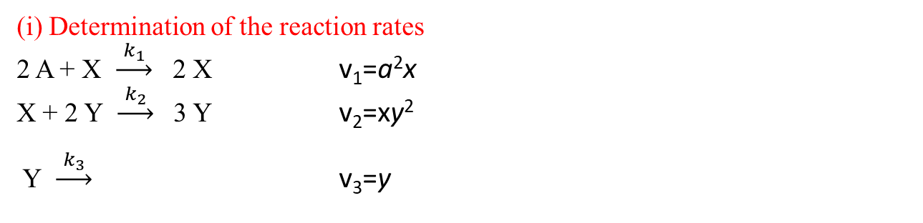
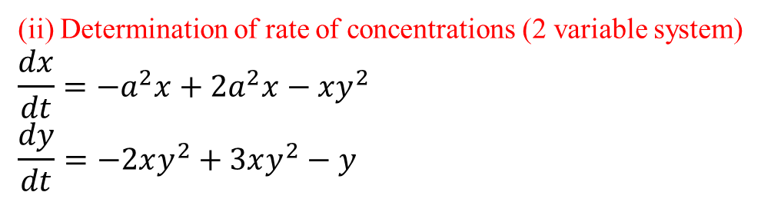


Problem
(i) Determination of the reaction rates
2 A + X $\underset{→}{{ k}_{1 }}$ 2 X v₁=a²x
X + 2 Y $\underset{→}{{ k}_{2 }}$ 3 Y v₂=xy²
Y $\underset{→}{{ k}_{3 }}$ v₃=y
Find the steady states of the system
Calculate the Jabobian matrix and calculate the eigenvalues
Characterize the steady states
Check your solution with the PhasePictor software
(ii) Determination of rate of concentrations (2 variable system)
$$\frac{dx}{dt}=−a^{2}x+2a^{2}x−xy^{2}$$
$$\frac{dy}{dt}=−2xy^{2}+3xy^{2}−y$$
$$\frac{dx}{dt}=a^{2}x−xy^{2}$$
$$\frac{dy}{dt}=xy^{2}−y$$
$$\frac{dx}{dt}=x−xy^{2}$$
$$\frac{dy}{dt}=xy^{2}−y$$

Slide 18
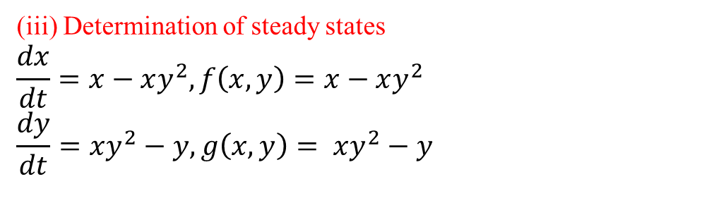
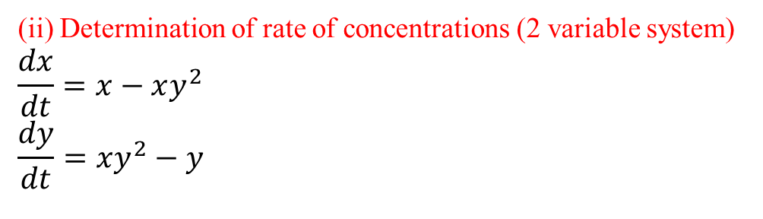
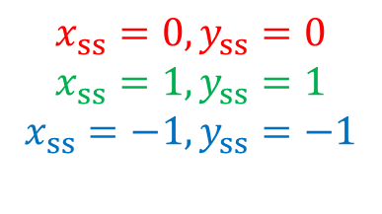
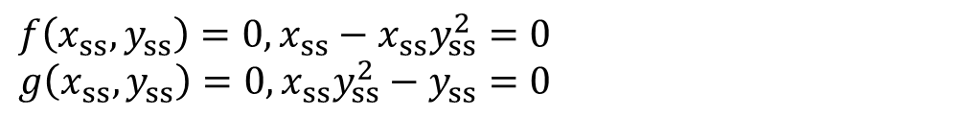
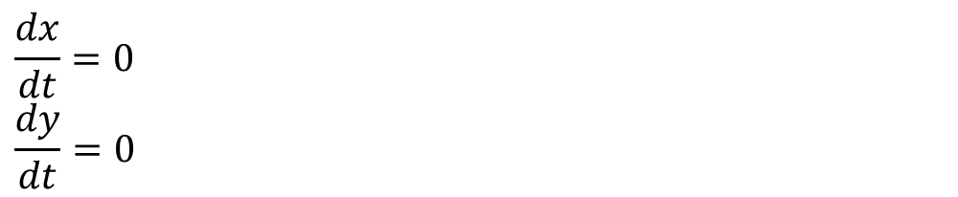
Problem
(ii) Determination of rate of concentrations (2 variable system)
$$\frac{dx}{dt}=x−xy^{2}$$
$$\frac{dy}{dt}=xy^{2}−y$$
Find the steady states of the system
Calculate the Jabobian matrix and calculate the eigenvalues
Characterize the steady states
Check your solution with the PhasePictor software
(iii) Determination of steady states
$$\frac{dx}{dt}=x−xy^{2},f\left(x,y\right)=x−xy^{2}$$
$$\frac{dy}{dt}=xy^{2}−y, g\left(x,y\right)= xy^{2}−y$$
$$\frac{dx}{dt}=0$$
$$\frac{dy}{dt}=0$$
$$f\left(x_{ss},y_{ss}\right)=0, x_{ss}−x_{ss}y_{ss}^{2}=0$$
$$g\left(x_{ss},y_{ss}\right)=0,x_{ss}y_{ss}^{2}−y_{ss}=0$$
$$x_{ss}=0,y_{ss}=0$$
$$x_{ss}=1,y_{ss}=1$$
$$x_{ss}=−1,y_{ss}=−1$$

Slide 19




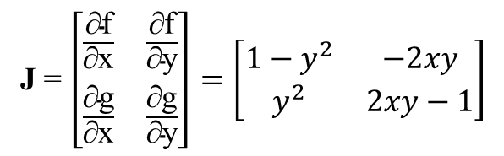

Problem
(iii) Determination of steady states
$$\frac{dx}{dt}=x−xy^{2},f\left(x,y\right)=x−xy^{2}$$
$$\frac{dy}{dt}=xy^{2}−y, g\left(x,y\right)= xy^{2}−y$$
$$x_{ss}=0,y_{ss}=0$$
$$x_{ss}=1,y_{ss}=1$$
$$x_{ss}=−1,y_{ss}=−1$$
(iv) Calculation of Jacobian matrix
J = $\left[\begin{matrix}\frac{\text{}\text{f}}{\text{}\text{x}} & \frac{\text{}\text{f}}{\text{}\text{y}} \\ \frac{\text{}\text{g}}{\text{}\text{x}} & \frac{\text{}\text{g}}{\text{}\text{y}}\end{matrix}\right]=\left[\begin{matrix}1−y^{2} & −2xy \\ y^{2} & 2xy−1\end{matrix}\right]$
(v) Characterization of steady states
$${\left(a\right) x}_{ss}=0,y_{ss}=0$$
$$\left[\begin{matrix}1 & 0 \\ 0 & −1\end{matrix}\right]$$
det$\left[\begin{matrix}1−λ & 0 \\ 0 & −1−λ\end{matrix}\right]=0$
(1–λ)(– 1 – λ) – 0 = 0
Jacobian
eigenvalues

Slide 20





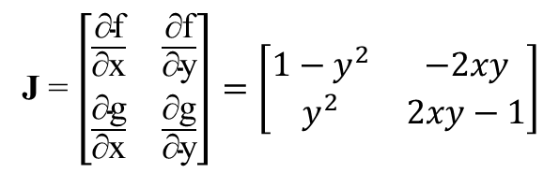
Problem
$$x_{ss}=0,y_{ss}=0$$
$$x_{ss}=1,y_{ss}=1$$
$$x_{ss}=−1,y_{ss}=−1$$
J = $\left[\begin{matrix}\frac{\text{}\text{f}}{\text{}\text{x}} & \frac{\text{}\text{f}}{\text{}\text{y}} \\ \frac{\text{}\text{g}}{\text{}\text{x}} & \frac{\text{}\text{g}}{\text{}\text{y}}\end{matrix}\right]=\left[\begin{matrix}1−y^{2} & −2xy \\ y^{2} & 2xy−1\end{matrix}\right]$
(v) Characterization of steady states
$${\left(a\right) x}_{ss}=0,y_{ss}=0$$
$$\left[\begin{matrix}1 & 0 \\ 0 & −1\end{matrix}\right]$$
det$\left[\begin{matrix}1−λ & 0 \\ 0 & −1−λ\end{matrix}\right]=0$
(1–λ)(– 1 – λ) – 0 = 0
Jacobian
eigenvalues
λ₁= 1, λ₂ = $−$1
saddle

Slide 21


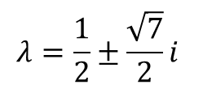


Problem
$$x_{ss}=0,y_{ss}=0$$
$$x_{ss}=1,y_{ss}=1$$
$$x_{ss}=−1,y_{ss}=−1$$
J = $\left[\begin{matrix}\frac{\text{}\text{f}}{\text{}\text{x}} & \frac{\text{}\text{f}}{\text{}\text{y}} \\ \frac{\text{}\text{g}}{\text{}\text{x}} & \frac{\text{}\text{g}}{\text{}\text{y}}\end{matrix}\right]=\left[\begin{matrix}1−y^{2} & −2xy \\ y^{2} & 2xy−1\end{matrix}\right]$
(v) Characterization of steady states
$${\left(b\right) x}_{ss}=1,y_{ss}=1$$
$$\left[\begin{matrix}0 & −2 \\ 1 & 1\end{matrix}\right]$$
det$\left[\begin{matrix}−λ & −2 \\ 1 & 1−λ\end{matrix}\right]=0$
(–λ)(1 – λ) +2 = 0
λ² – λ + 2 = 0
Jacobian
eigenvalues
$$λ=\frac{1}{2}±\frac{\sqrt{7}}{2}i$$
$${\left(c\right) x}_{ss}=−1,y_{ss}=−1$$
unstable focus

