Slide 1
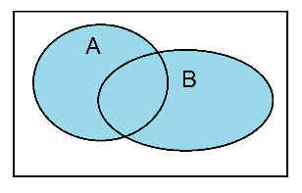
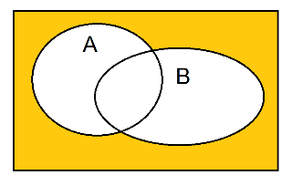

De Morgan’ Laws
$\overline{ \text{A}\text{ + }\text{B}}$ = $\overline{\text{A}}\text{ ∙ }\overline{\text{B}}$
A + B $\overline{\text{A}\text{ + }\text{B}}$

Slide 2
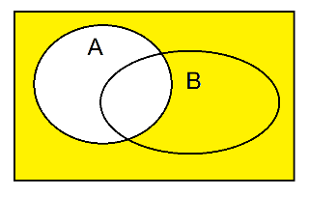
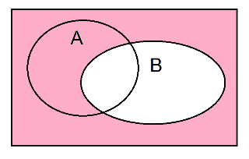

De Morgan’ Laws
$\overline{ \text{A}\text{ + }\text{B}}$ = $\overline{\text{A}}\text{ ∙ }\overline{\text{B}}$
A + B $\overline{\text{A}\text{ + }\text{B}}$
$\overline{\text{A}} \overline{\text{B}} \overline{\text{A}}\text{ ∙ }\overline{\text{B}}$

Slide 3
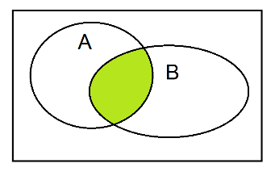
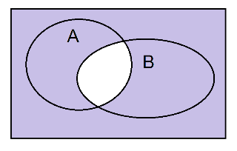

De Morgan’ Laws
$\overline{ \text{A} ∙ \text{B}}$ = $\overline{\text{A}} \text{+} \overline{\text{B}}$
A ∙ B $\overline{ \text{A} ∙ \text{B}}$

Slide 4

De Morgan’ Laws
$\overline{ \text{A} ∙ \text{B}}$ = $\overline{\text{A}} \text{+} \overline{\text{B}}$
A ∙ B $\overline{ \text{A} ∙ \text{B}}$
$\overline{\text{A}} \overline{\text{B}} \overline{\text{A}} \text{+} \overline{\text{B}}$

Slide 5

De Morgan’ Laws
$\overline{ \text{A}\text{ + }\text{B}}$ = $\overline{\text{A}}\text{ ∙ }\overline{\text{B}}$ $\overline{\overline{ \text{A}\text{ + }\text{B}}}$ = $\overline{\overline{\text{A}}\text{ ∙ }\overline{\text{B}}}$
$\overline{ \text{A} ∙ \text{B}}$ = $\overline{\text{A}}\text{ + }\overline{\text{B}}$ $\overline{\overline{ \text{A}\text{ ∙ }\text{B}}}$ = $\overline{\overline{\text{A}}\text{ + }\overline{\text{B}}}$

Slide 6
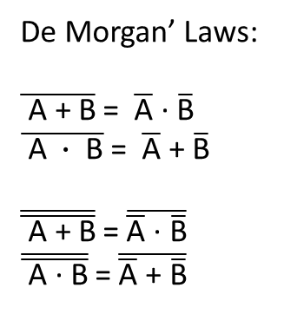

De Morgan’ Laws:
$\overline{ \text{A}\text{ + }\text{B}}$ = $\overline{\text{A}}\text{ ∙ }\overline{\text{B}}$
$\overline{ \text{A} ∙ \text{B}}$ = $\overline{\text{A}}\text{ + }\overline{\text{B}}$
$\overline{\overline{ \text{A}\text{ + }\text{B}}}$ = $\overline{\overline{\text{A}}\text{ ∙ }\overline{\text{B}}}$
$\overline{\overline{ \text{A}\text{ ∙ }\text{B}}}$ = $\overline{\overline{\text{A}}\text{ + }\overline{\text{B}}}$
Let us show that
A + B ∙ C → → → ( A + B ) ∙ ( A + C )
Y = A + B ∙ C = $\overline{\overline{ \text{A}\text{ + }\text{B}\text{ ∙ }\text{C} }}$

Slide 7

De Morgan’ Laws:
$\overline{ \text{A}\text{ + }\text{B}}$ = $\overline{\text{A}}\text{ ∙ }\overline{\text{B}}$
$\overline{ \text{A} ∙ \text{B}}$ = $\overline{\text{A}}\text{ + }\overline{\text{B}}$
$\overline{\overline{ \text{A}\text{ + }\text{B}}}$ = $\overline{\overline{\text{A}}\text{ ∙ }\overline{\text{B}}}$
$\overline{\overline{ \text{A}\text{ ∙ }\text{B}}}$ = $\overline{\overline{\text{A}}\text{ + }\overline{\text{B}}}$
A + B ∙ C → → → ( A + B ) ∙ ( A + C )
Y = A + B ∙ C = $\overline{\overline{ \text{A}\text{ + }\text{B}\text{ ∙ }\text{C} }}$
$\overline{\overline{ \text{A}\text{ + }\text{B}\text{ ∙ }\text{C} }} \underset{→}{?}$ $\overline{\overline{\text{A}} \text{∙} \overline{\text{B}\text{ ∙ }\text{C}}}$
$\overline{\overline{ \text{A}\text{ + }\text{B}\text{ ∙ }\text{C} }} \underset{→}{?}$ $\overline{\overline{\text{A} \text{+} \text{B}} \text{+} \overline{\text{C}}}$
$\overline{\overline{ \text{A}\text{ + }\text{B}\text{ ∙ }\text{C} }} \underset{→}{?}$ $\overline{\overline{\text{A}} \text{∙} \overline{\text{B}} \text{+} \overline{\text{C}}}$

Slide 8

De Morgan’ Laws:
$\overline{ \text{A}\text{ + }\text{B}}$ = $\overline{\text{A}}\text{ ∙ }\overline{\text{B}}$
$\overline{ \text{A} ∙ \text{B}}$ = $\overline{\text{A}}\text{ + }\overline{\text{B}}$
$\overline{\overline{ \text{A}\text{ + }\text{B}}}$ = $\overline{\overline{\text{A}}\text{ ∙ }\overline{\text{B}}}$
$\overline{\overline{ \text{A}\text{ ∙ }\text{B}}}$ = $\overline{\overline{\text{A}}\text{ + }\overline{\text{B}}}$
Y = A + B ∙ C = $\overline{\overline{ \text{A}\text{ + }\text{B}\text{ ∙ }\text{C} }}$
$\overline{\overline{ \text{A}\text{ + }\text{B}\text{ ∙ }\text{C} }}=$ $\overline{\overline{\text{A}} \text{∙} \overline{\text{B}\text{ ∙ }\text{C}}}$
$\overline{\overline{ \text{A}\text{ + }\text{B}\text{ ∙ }\text{C} }} ≠$ $\overline{\overline{\text{A} \text{+} \text{B}} \text{+} \overline{\text{C}}}$
$\overline{\overline{ \text{A}\text{ + }\text{B}\text{ ∙ }\text{C} }}≠\overline{\overline{\text{A}} \text{∙} \overline{\text{B}} \text{+} \overline{\text{C}}}$

Slide 9
De Morgan’ Laws:
$\overline{ \text{A}\text{ + }\text{B}}$ = $\overline{\text{A}}\text{ ∙ }\overline{\text{B}}$
$\overline{ \text{A} ∙ \text{B}}$ = $\overline{\text{A}}\text{ + }\overline{\text{B}}$
$\overline{\overline{ \text{A}\text{ + }\text{B}}}$ = $\overline{\overline{\text{A}}\text{ ∙ }\overline{\text{B}}}$
$\overline{\overline{ \text{A}\text{ ∙ }\text{B}}}$ = $\overline{\overline{\text{A}}\text{ + }\overline{\text{B}}}$
Y = A + B ∙ C =$\overline{\overline{ \text{A}\text{ + }\text{B}\text{ ∙ }\text{C} }}$= $\overline{\overline{\text{A}}\text{ ∙ }\overline{\text{B}\text{ ∙ }\text{C}}}$

Slide 10
De Morgan’ Laws:
$\overline{ \text{A}\text{ + }\text{B}}$ = $\overline{\text{A}}\text{ ∙ }\overline{\text{B}}$
$\overline{ \text{A} ∙ \text{B}}$ = $\overline{\text{A}}\text{ + }\overline{\text{B}}$
$\overline{\overline{ \text{A}\text{ + }\text{B}}}$ = $\overline{\overline{\text{A}}\text{ ∙ }\overline{\text{B}}}$
$\overline{\overline{ \text{A}\text{ ∙ }\text{B}}}$ = $\overline{\overline{\text{A}}\text{ + }\overline{\text{B}}}$
Y = A + B ∙ C =$\overline{\overline{ \text{A}\text{ + }\text{B}\text{ ∙ }\text{C} }}$= $\overline{\overline{\text{A}}\text{ ∙ }\overline{\text{B}\text{ ∙ }\text{C}}}$ = $\overline{\overline{\text{A}}\text{ ∙ }\left(\overline{\text{B}}\text{ + }\overline{\text{C}}\right)}$

Slide 11
De Morgan’ Laws:
$\overline{ \text{A}\text{ + }\text{B}}$ = $\overline{\text{A}}\text{ ∙ }\overline{\text{B}}$
$\overline{ \text{A} ∙ \text{B}}$ = $\overline{\text{A}}\text{ + }\overline{\text{B}}$
$\overline{\overline{ \text{A}\text{ + }\text{B}}}$ = $\overline{\overline{\text{A}}\text{ ∙ }\overline{\text{B}}}$
$\overline{\overline{ \text{A}\text{ ∙ }\text{B}}}$ = $\overline{\overline{\text{A}}\text{ + }\overline{\text{B}}}$
Y = A + B ∙ C =$\overline{\overline{ \text{A}\text{ + }\text{B}\text{ ∙ }\text{C} }}$= $\overline{\overline{\text{A}}\text{ ∙ }\overline{\text{B}\text{ ∙ }\text{C}}}$ = $\overline{\overline{\text{A}}\text{ ∙ }\left(\overline{\text{B}}\text{ + }\overline{\text{C}}\right)}$ = $\overline{\overline{\text{A}} \text{∙} \overline{\text{B}}\text{ + }\overline{\text{A}} \text{∙} \overline{\text{C}}}$

Slide 12
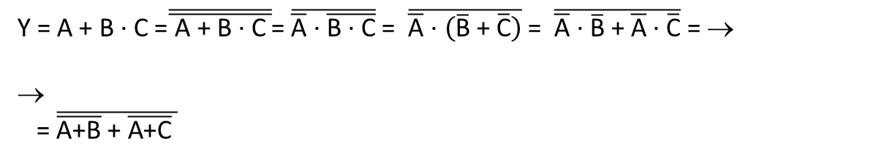
De Morgan’ Laws:
$\overline{ \text{A}\text{ + }\text{B}}$ = $\overline{\text{A}}\text{ ∙ }\overline{\text{B}}$
$\overline{ \text{A} ∙ \text{B}}$ = $\overline{\text{A}}\text{ + }\overline{\text{B}}$
$\overline{\overline{ \text{A}\text{ + }\text{B}}}$ = $\overline{\overline{\text{A}}\text{ ∙ }\overline{\text{B}}}$
$\overline{\overline{ \text{A}\text{ ∙ }\text{B}}}$ = $\overline{\overline{\text{A}}\text{ + }\overline{\text{B}}}$
Y = A + B ∙ C =$\overline{\overline{ \text{A}\text{ + }\text{B}\text{ ∙ }\text{C} }}$= $\overline{\overline{\text{A}}\text{ ∙ }\overline{\text{B}\text{ ∙ }\text{C}}}$ = $\overline{\overline{\text{A}}\text{ ∙ }\left(\overline{\text{B}}\text{ + }\overline{\text{C}}\right)}$ = $\overline{\overline{\text{A}} \text{∙} \overline{\text{B}}\text{ + }\overline{\text{A}} \text{∙} \overline{\text{C}}}$ = →
→
= $\overline{\overline{\text{A}\text{+}\text{B}}\text{ + }\overline{\text{A}\text{+}\text{C}} }$

Slide 13
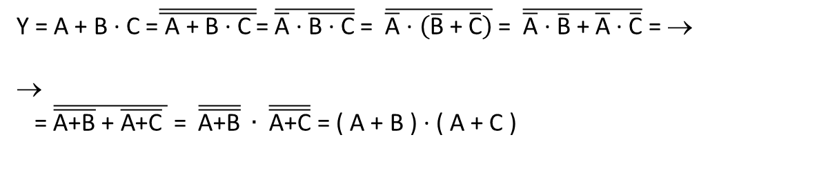
De Morgan’ Laws:
$\overline{ \text{A}\text{ + }\text{B}}$ = $\overline{\text{A}}\text{ ∙ }\overline{\text{B}}$
$\overline{ \text{A} ∙ \text{B}}$ = $\overline{\text{A}}\text{ + }\overline{\text{B}}$
$\overline{\overline{ \text{A}\text{ + }\text{B}}}$ = $\overline{\overline{\text{A}}\text{ ∙ }\overline{\text{B}}}$
$\overline{\overline{ \text{A}\text{ ∙ }\text{B}}}$ = $\overline{\overline{\text{A}}\text{ + }\overline{\text{B}}}$
Y = A + B ∙ C =$\overline{\overline{ \text{A}\text{ + }\text{B}\text{ ∙ }\text{C} }}$= $\overline{\overline{\text{A}}\text{ ∙ }\overline{\text{B}\text{ ∙ }\text{C}}}$ = $\overline{\overline{\text{A}}\text{ ∙ }\left(\overline{\text{B}}\text{ + }\overline{\text{C}}\right)}$ = $\overline{\overline{\text{A}} \text{∙} \overline{\text{B}}\text{ + }\overline{\text{A}} \text{∙} \overline{\text{C}}}$ = →
→
= $\overline{\overline{\text{A}\text{+}\text{B}}\text{ + }\overline{\text{A}\text{+}\text{C}} }$ = $\overline{\overline{\text{A}\text{+}\text{B}}} ∙ \overline{\overline{\text{A}\text{+}\text{C}}}$ = ( A + B ) ∙ ( A + C )

Slide 14
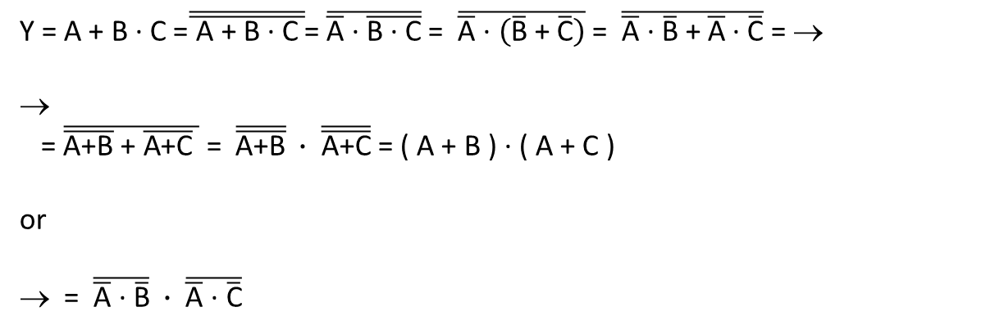
De Morgan’ Laws:
$\overline{ \text{A}\text{ + }\text{B}}$ = $\overline{\text{A}}\text{ ∙ }\overline{\text{B}}$
$\overline{ \text{A} ∙ \text{B}}$ = $\overline{\text{A}}\text{ + }\overline{\text{B}}$
$\overline{\overline{ \text{A}\text{ + }\text{B}}}$ = $\overline{\overline{\text{A}}\text{ ∙ }\overline{\text{B}}}$
$\overline{\overline{ \text{A}\text{ ∙ }\text{B}}}$ = $\overline{\overline{\text{A}}\text{ + }\overline{\text{B}}}$
Y = A + B ∙ C =$\overline{\overline{ \text{A}\text{ + }\text{B}\text{ ∙ }\text{C} }}$= $\overline{\overline{\text{A}}\text{ ∙ }\overline{\text{B}\text{ ∙ }\text{C}}}$ = $\overline{\overline{\text{A}}\text{ ∙ }\left(\overline{\text{B}}\text{ + }\overline{\text{C}}\right)}$ = $\overline{\overline{\text{A}} \text{∙} \overline{\text{B}}\text{ + }\overline{\text{A}} \text{∙} \overline{\text{C}}}$ = →
→
= $\overline{\overline{\text{A}\text{+}\text{B}}\text{ + }\overline{\text{A}\text{+}\text{C}} }$ = $\overline{\overline{\text{A}\text{+}\text{B}}} ∙ \overline{\overline{\text{A}\text{+}\text{C}}}$ = ( A + B ) ∙ ( A + C )
or
→ = $\overline{\overline{\text{A}}\text{ ∙ }\overline{\text{B}}} ∙ \overline{\overline{\text{A}}\text{ ∙ }\overline{\text{C}}}$

Slide 15
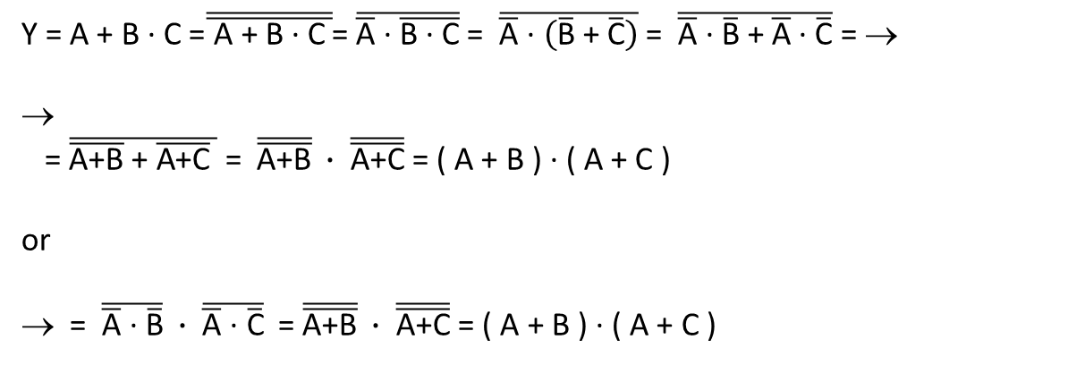
De Morgan’ Laws:
$\overline{ \text{A}\text{ + }\text{B}}$ = $\overline{\text{A}}\text{ ∙ }\overline{\text{B}}$
$\overline{ \text{A} ∙ \text{B}}$ = $\overline{\text{A}}\text{ + }\overline{\text{B}}$
$\overline{\overline{ \text{A}\text{ + }\text{B}}}$ = $\overline{\overline{\text{A}}\text{ ∙ }\overline{\text{B}}}$
$\overline{\overline{ \text{A}\text{ ∙ }\text{B}}}$ = $\overline{\overline{\text{A}}\text{ + }\overline{\text{B}}}$
Y = A + B ∙ C =$\overline{\overline{ \text{A}\text{ + }\text{B}\text{ ∙ }\text{C} }}$= $\overline{\overline{\text{A}}\text{ ∙ }\overline{\text{B}\text{ ∙ }\text{C}}}$ = $\overline{\overline{\text{A}}\text{ ∙ }\left(\overline{\text{B}}\text{ + }\overline{\text{C}}\right)}$ = $\overline{\overline{\text{A}} \text{∙} \overline{\text{B}}\text{ + }\overline{\text{A}} \text{∙} \overline{\text{C}}}$ = →
→
= $\overline{\overline{\text{A}\text{+}\text{B}}\text{ + }\overline{\text{A}\text{+}\text{C}} }$ = $\overline{\overline{\text{A}\text{+}\text{B}}} ∙ \overline{\overline{\text{A}\text{+}\text{C}}}$ = ( A + B ) ∙ ( A + C )
or
→ = $\overline{\overline{\text{A}}\text{ ∙ }\overline{\text{B}}} ∙ \overline{\overline{\text{A}}\text{ ∙ }\overline{\text{C}}}$ = $\overline{\overline{\text{A}\text{+}\text{B}}} ∙ \overline{\overline{\text{A}\text{+}\text{C}}}$ = ( A + B ) ∙ ( A + C )

Slide 16
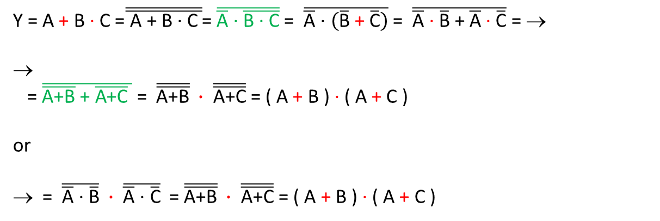
Y = A + B ∙ C =$\overline{\overline{ \text{A}\text{ + }\text{B}\text{ ∙ }\text{C} }}$= $\overline{\overline{\text{A}}\text{ ∙ }\overline{\text{B}\text{ ∙ }\text{C}}}$ = $\overline{\overline{\text{A}}\text{ ∙ }\left(\overline{\text{B}} \text{+} \overline{\text{C}}\right)}$ = $\overline{\overline{\text{A}} \text{∙} \overline{\text{B}}\text{ + }\overline{\text{A}} \text{∙} \overline{\text{C}}}$ = →
→
= $\overline{\overline{\text{A}\text{+}\text{B}}\text{ + }\overline{\text{A}\text{+}\text{C}} }$ = $\overline{\overline{\text{A}\text{+}\text{B}}} ∙ \overline{\overline{\text{A}\text{+}\text{C}}}$ = ( A + B ) ∙ ( A + C )
or
→ = $\overline{\overline{\text{A}}\text{ ∙ }\overline{\text{B}}} ∙ \overline{\overline{\text{A}}\text{ ∙ }\overline{\text{C}}}$ = $\overline{\overline{\text{A}\text{+}\text{B}}} ∙ \overline{\overline{\text{A}\text{+}\text{C}}}$ = ( A + B ) ∙ ( A + C )

Slide 17

Y = A + B ∙ C = $\overline{\overline{\text{A}}\text{ ∙ }\overline{\text{B}\text{ ∙ }\text{C}}}$ = $\overline{\overline{\text{A} \text{+} \text{B}}\text{ + }\overline{\text{A} \text{+} \text{C}} }$
A | B | C | Y = A + B ∙ C
0 | 0 | 0 | 0
0 | 0 | 1 | 0
0 | 1 | 0 | 0
0 | 1 | 1 | 1
1 | 0 | 0 | 1
1 | 0 | 1 | 1
1 | 1 | 0 | 1
1 | 1 | 1 | 1

